Slide 1
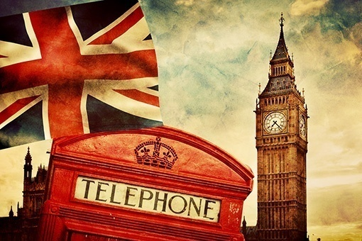
Britain Quiz

Slide 2
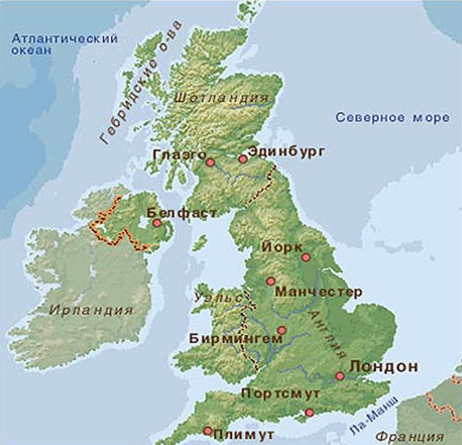
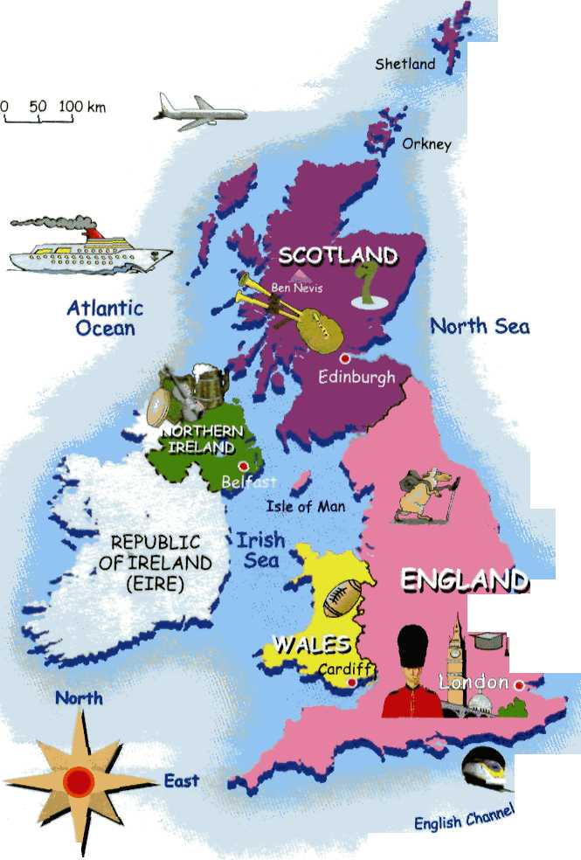
The main Parts of Great Britain are
a) Cambridge
b) Wales
c) Scotland
d) England
c) Glasgow

Slide 3
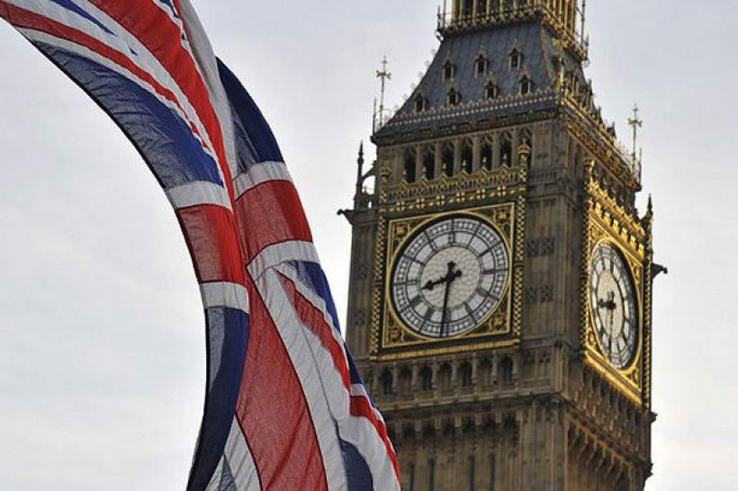
What kind of state is the UK?
a) republic
b) parliamentary monarchy
c) monarchy

Slide 4
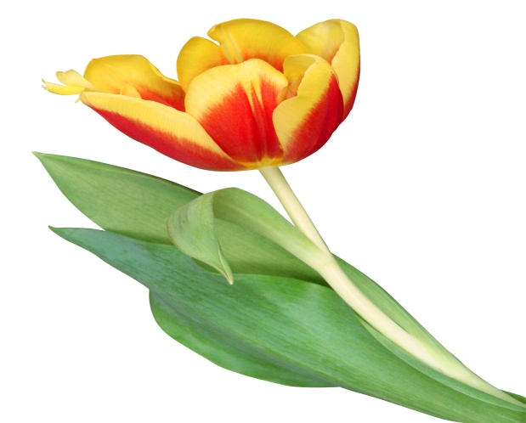
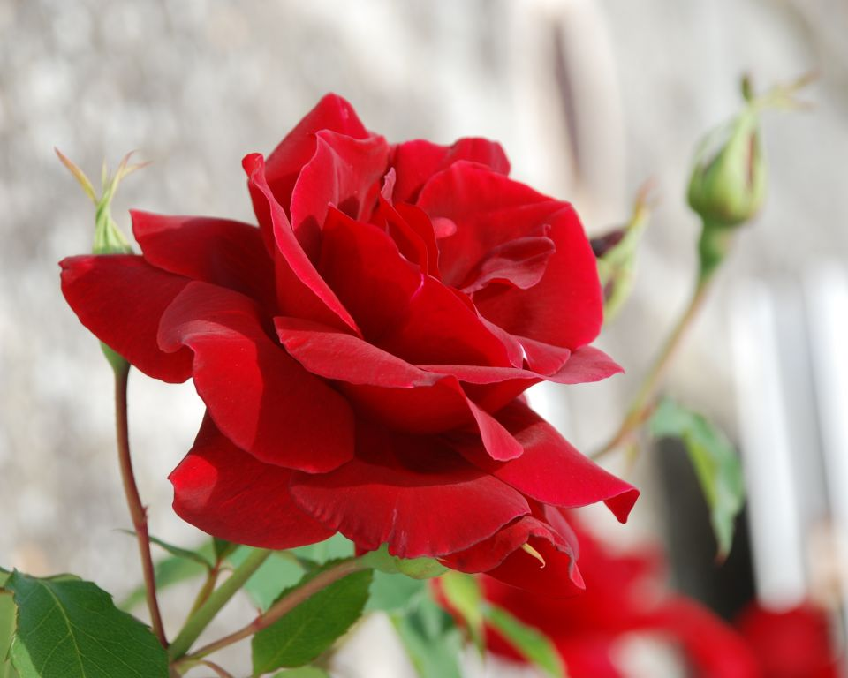
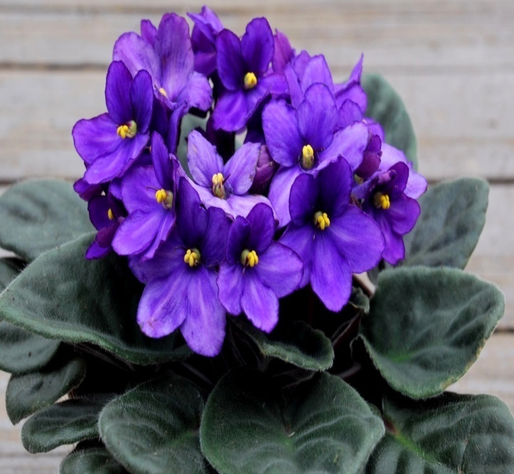
What is the national emblem of England?
a) violet
b) rose
c) tulip

Slide 5
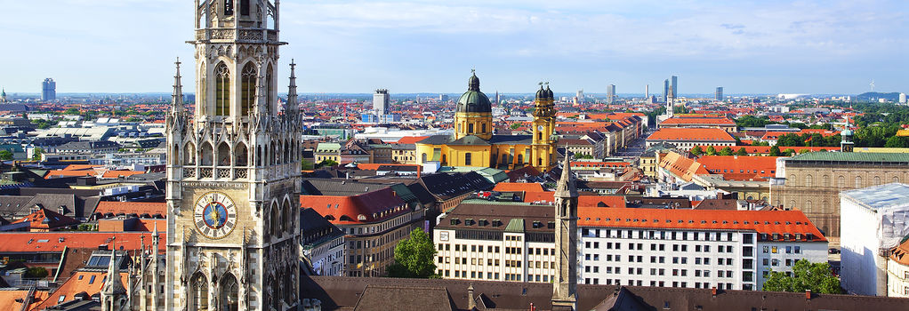
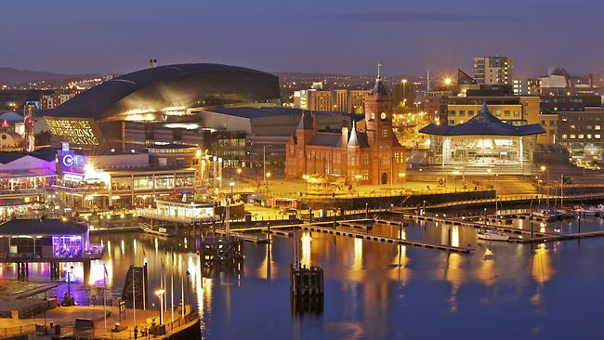
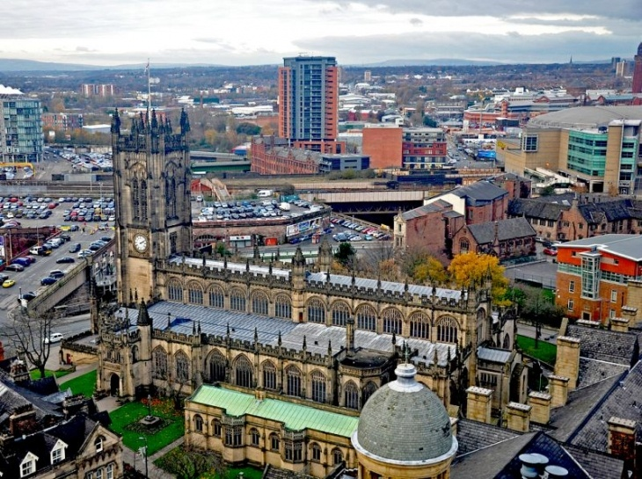
The capital of Wales is
a) Manchester
b) Cardiff
c) Birmingham

Slide 6
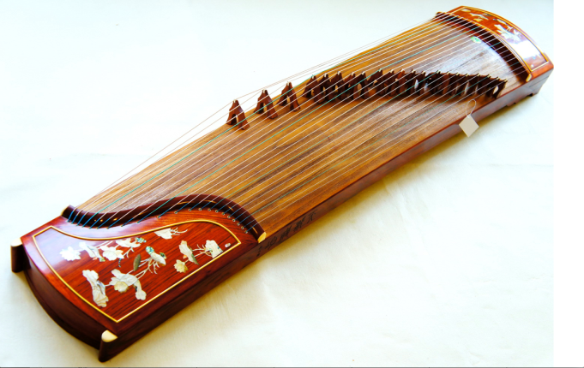
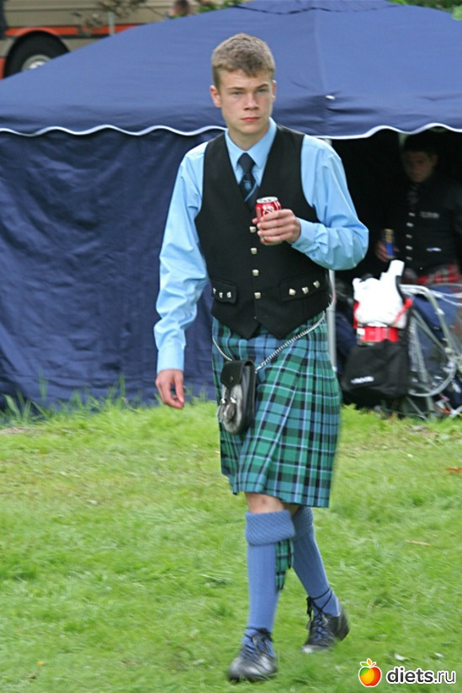
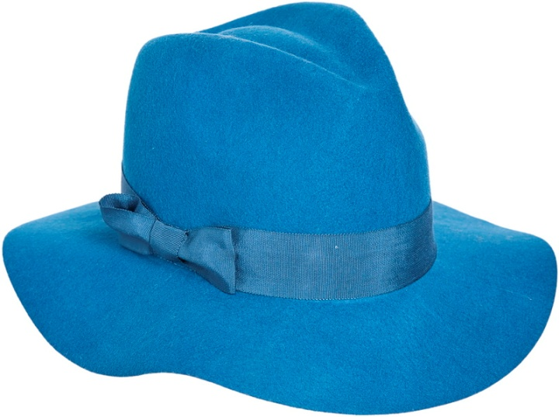
The kilt is
a) musical instrument
b) short skirt
c) hat

Slide 7
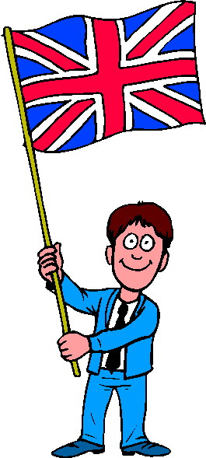
The British flag is often called
a) the Union Jack
b) the Stars and Stripes
c) the Maple Leaf

Slide 8
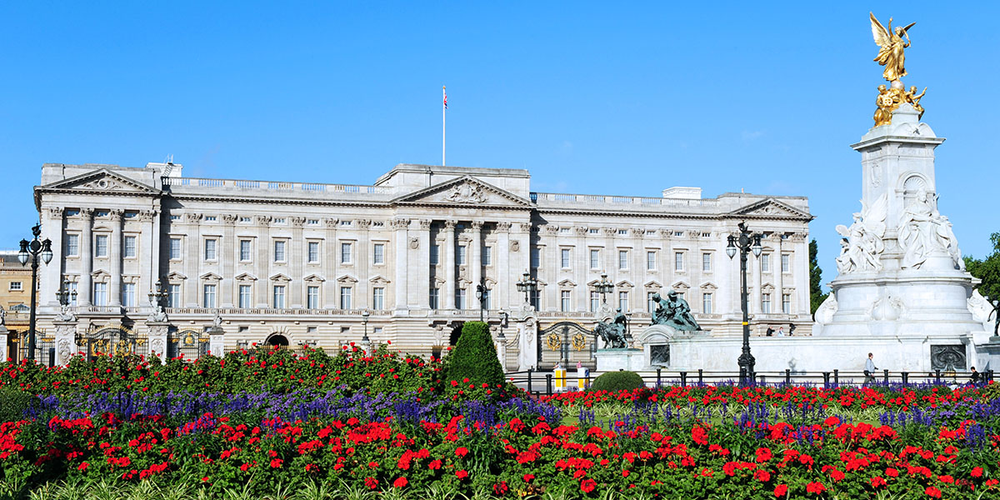
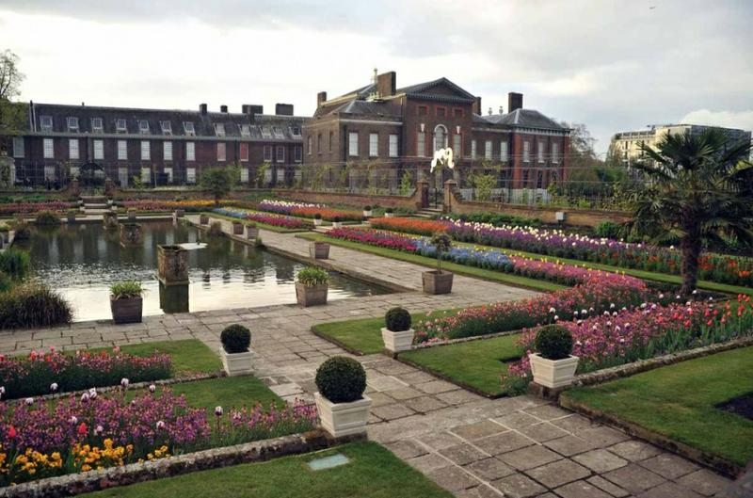
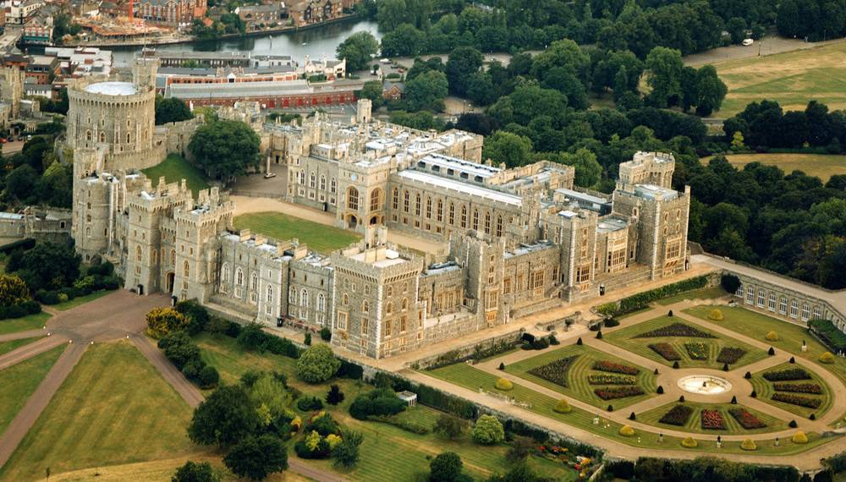
What I the name of the London residence of Queen Elizabeth the II ?
a) Windsor Palace
b) Kensington Palace
c) Buckingham Palace

Slide 9
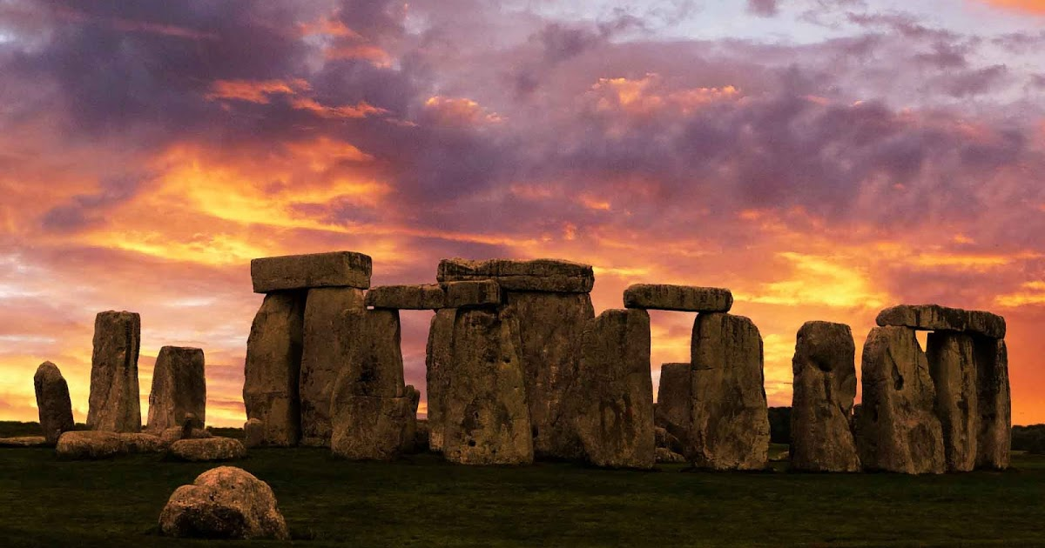
Stonehenge is ……years old 40 400 4000

Slide 10
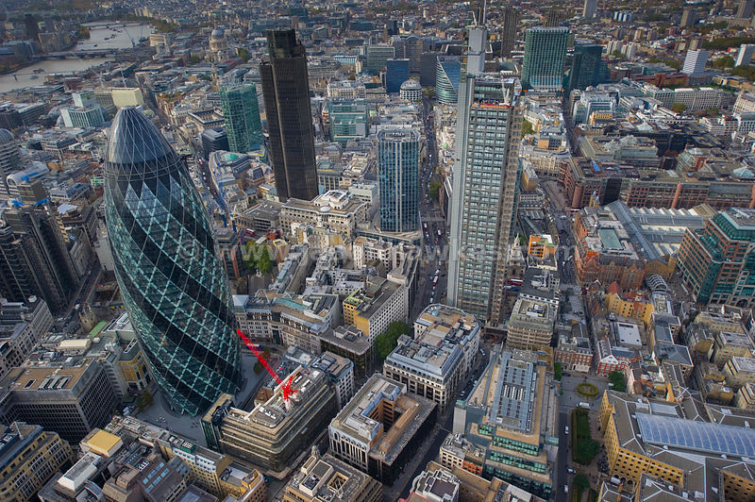
What part is called the Сity of London?
a) the oldest
b) the richest
c ) the poorest

Slide 11
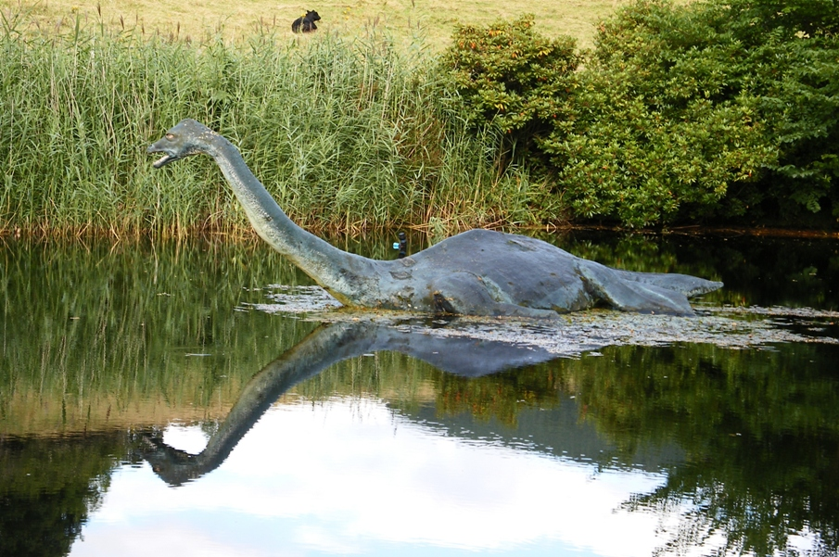
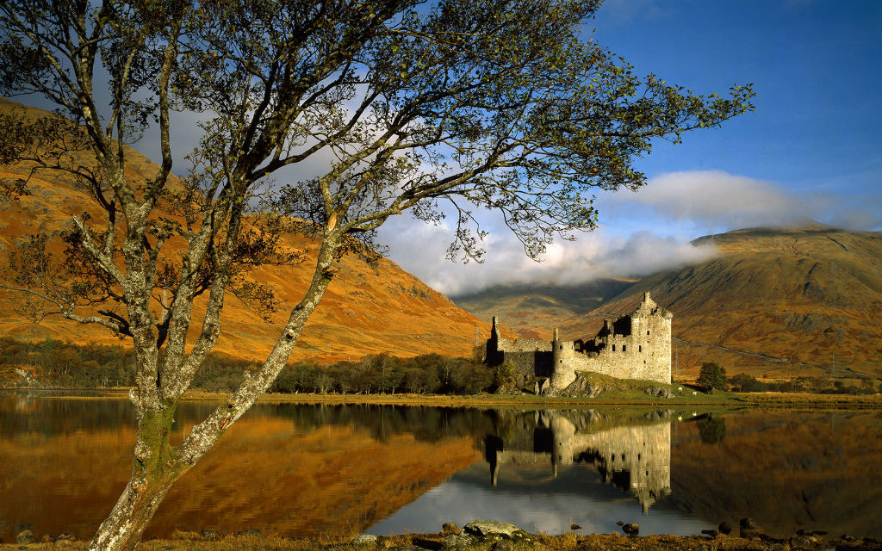
The mysterious Loch Ness Monster is from
a) Wales
b) Ireland
c) Scotland

