Slide 1
Seasons and Weather.
Выполнила РусаковаС.А.
учитель английского языка
МОУ Фировская СОШ

Slide 2
Let`s speak about the weather!
What kind of season do you like best of all?
What is your favourite month?
Is the weather fine in spring?
How often do people in Britain speak about the weather?

Slide 3
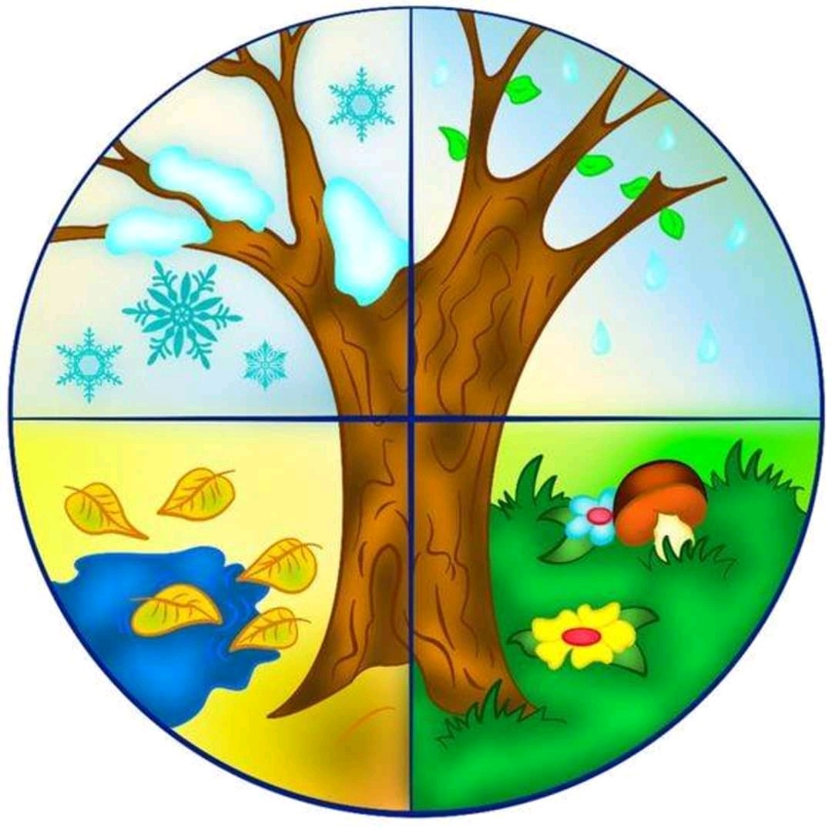
Seasons.
Winter
Autumn
Spring
Summer
Spring

Slide 4
Найди лишнее слово. 1.August, December, June, July. 2. April, May, January, March. 3. September, November, October, June. 4. July, December, January, February

Slide 5
Вставьте пропущенные слова.
Birds, are, summer, can , trees , autumn , sometimes, not, see, are, can, season , is.
It is….. . The weather … usually sunny and warm. Children… be outdoors all day long. It is a beautiful… . You can… many flowers in the park.
But what can you say about…? It is… very warm. It is … cold and rainy. The … are very bright. There …. many fruit and vegetables. …. Fly away because it is getting cold.

Slide 6
Источники
http://egoel.ru/post291898881/ насекомые отрисовки PNG
http://egoel.ru/post233645077/ анимация
http://lenagold.ru/fon/clipart/b/bab/babochka57.gif анимация бабочка
http://www.liveinternet.ru/users/yuliya0284/post283947722/фон

